Slide 1
Chapter 6
Political Socialization and Public Opinion
American Democracy Now, 7th edition
Brigid Callahan Harrison
Jean Wahl Harris
Michelle D. Deardorff

Slide 2
Political Socialization and Civic Participation
Process by which we develop our political values and opinions is called political socialization.
Children absorb the political views of their parents.
One key aspect of political socialization is whether children are socialized to participate in politics.

Slide 3
The Process of Political Socialization
Family and school have the strongest influence on political socialization.
In recent times, media have also become one of the prime agents of political socialization.

Slide 4
Participating in Civic Life
Children whose parents are active in politics or in their community are more likely to be active themselves.
Schools also play an important role in socializing young people to become active in civic life.
There is a strong link between being informed and the likelihood of engaging in civic participation.
People who lack political knowledge tend not to be actively involved in their communities.

Slide 5
Agents of Socialization
Learning, culture, and socialization occur through agents of socialization: the individuals, organizations, and institutions that facilitate the acquisition of political views.

Slide 6
Family Influences on Attitudes, Opinions, and Actions
We learn whether our family members value civic activism by observing their actions and listening to their views.
Our families also influence what we believe.
While parents or older siblings may discuss specific issues or policies, their attitudes and outlook also shape children’s general political attitudes and ideology.
Weekly Reader poll.

Slide 7
The Media’s Ever-Increasing Role in Socialization
Television, radio, social media, the Internet, and various forms of electronic entertainment and print media help shape our political perspectives.
Help shape societal norms and reinforce core democratic values.
Help to determine the national agenda.
Educate the public about policy issues.

Slide 8
Schools, Patriotism, and Civic Participation
As early as preschool, children in the United States are socialized to believe in democracy and express patriotism.
Schools socialize children to the concept of democracy by making the idea tangible for them.
Research indicates that higher levels of education are associated with higher levels of political activism, which is passed through generations.

Slide 9
Religious Institutions: Faith as an Agent of Socialization
Predictor of the impact of religion on voting is not so much the religion an individual practices but how regularly he or she practices it.
In general, those who regularly attend religious services are more likely to share conservative values—and support Republican candidates in general elections.
Relationship is particularly strong among white Protestants but less so among Catholics and among African Americans.

Slide 10
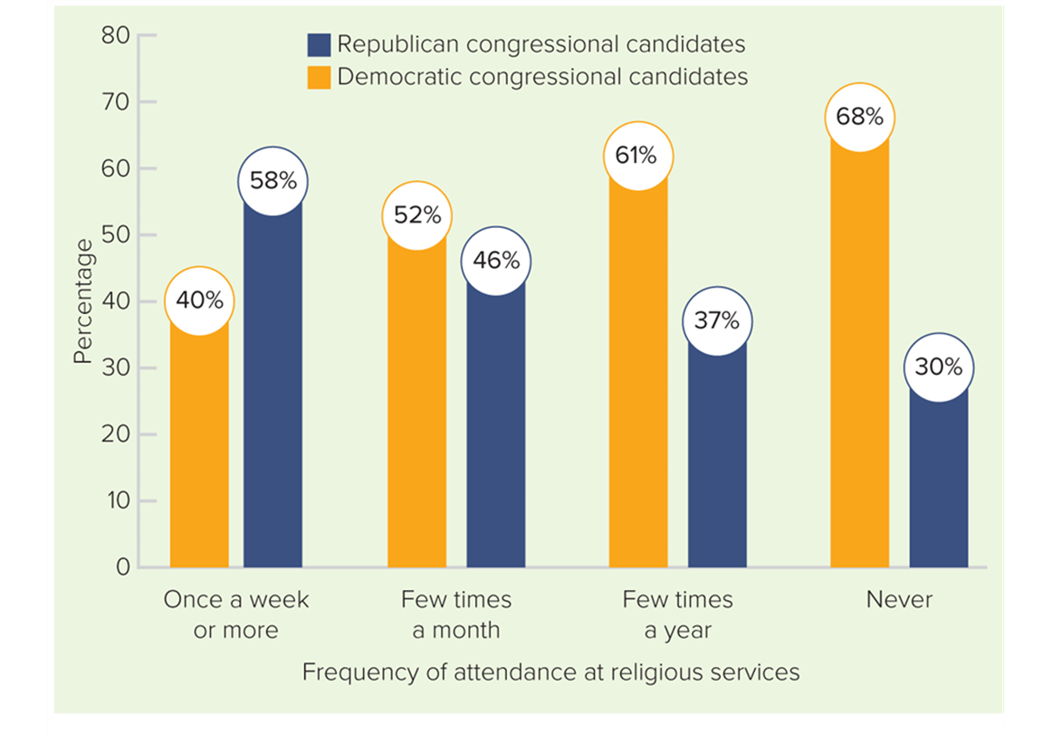
Figure 6.1 Candidate Preference of Religious and Non-Religious Americans
Access the text alternative for slide images.
SOURCE: www.pewresearch.org/fact-tank/2018/11/07/how-religious-garoups-voted-in-the-midterm-elections/

Slide 11
Peers and Group Norms
Friends, neighbors, coworkers, and other peers influence political socialization.
Research indicates that the primary function of peers is to reinforce our already-held beliefs and values.

Slide 12
Political and Community Leaders: Opinion Shapers
Political and community leaders also help to socialize people and influence public opinion.
President plays an especially important role in shaping Americans’ views.
Often we rely on the recommendations and priorities of well-respected leaders who have earned our trust.
People in other kinds of leadership roles also influence our opinions.
Example: student activists of Marjory Stoneman Douglas High School after the mass shooting of 2018.

Slide 13
Demographic Characteristics: Our Politics Are a Reflection of Us
Who we are often influences our life experiences, which shape our political socialization and therefore what we think.
Racial and ethnic groups to which we belong, our gender, our age, and where we live all play a role in how we are socialized to political and community life.

Slide 14
Race and Ethnicity
In general, whites, African Americans, Latinos, and Asian Americans prefer different candidates, hold different political views, and have different levels of civic involvement.

Slide 15
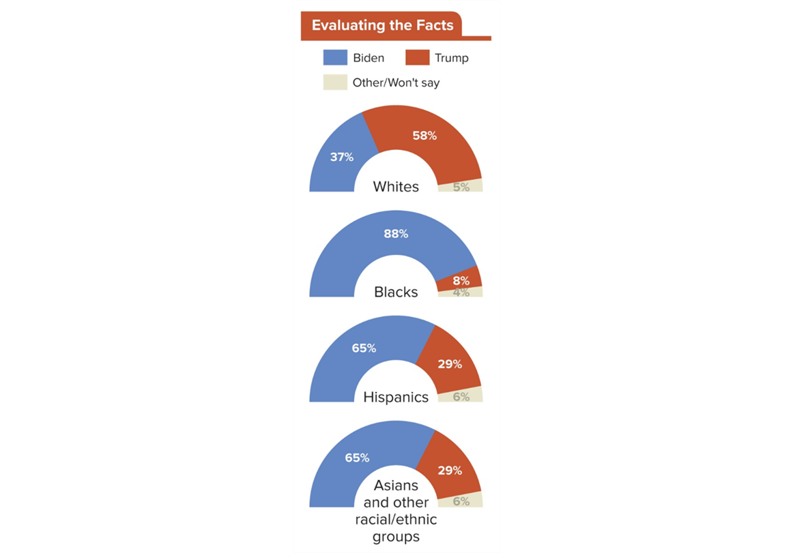
Figure 6.2 Candidate Support by Racial and Ethnic Group
SOURCE: Pew Research Center.

Slide 16
Table 6.1 Latinx Party Identification by National Origin
NATIONAL ORIGIN | REPUBLICAN | DEMOCRATIC | INDEPENDENT
Puerto Rican | 22% | 57% | 21%
Mexican | 22% | 55% | 23%
Cuban | 33% | 48% | 19%
Dominican | 7% | 80% | 13%
Salvadoran | 12% | 52% | 36%
Other | 15% | 41% | 44%
Table divided into two columns summarizes Latinx party identification by national origin. The column headers are: National origin and party identification. Column 2, party identification, is further divided into 3 sub-columns marked as: Republican, Democratic, and Independent.
SOURCE: Pew Research Center Survey of Hispanic adults, May 24-July 28, 2013, Pew Research Center.

Slide 17
Gender
Gender gap: the measurable difference in the way women and men vote for candidates and in the way they view political issues.
Since the 1980 election, women voters are more likely than men to favor Democratic candidates.
Women in most age groups—except those under age 25—are more likely to vote than their male counterparts.
Women’s and men’s opinions also differ on public policy, although often in unexpected ways.

Slide 18
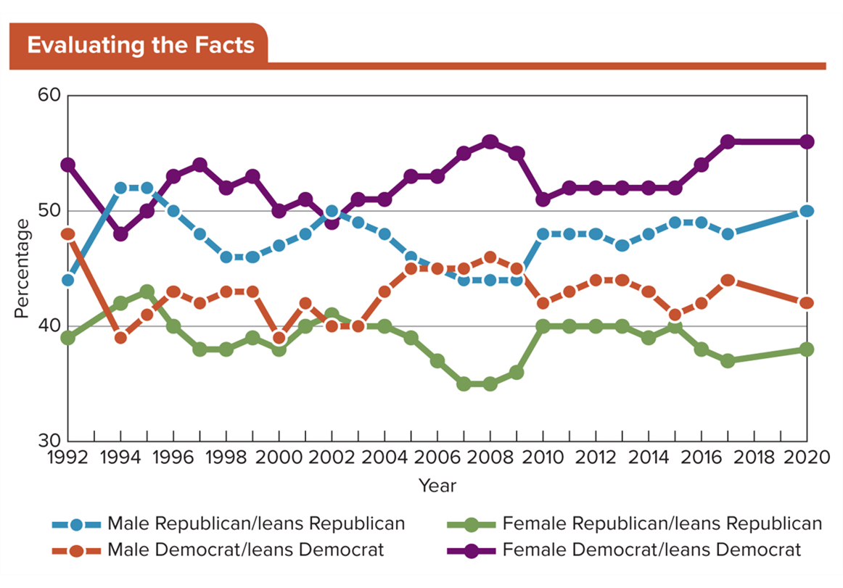
Figure 6.3 Party Identification Among Men and Women
Access the text alternative for slide images.
SOURCE: Pew Research Center

Slide 19
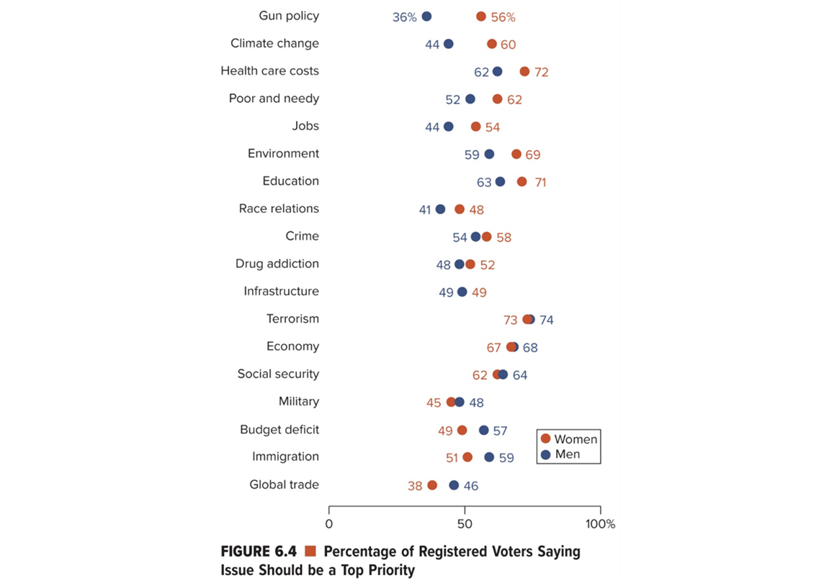
Figure 6.4 Percentage of Registered Voters Saying Issue Should Be a Top Priority
Access the text alternative for slide images.
SOURCE: Pew Research Center.

Slide 20
Geographic Region
Among the most important regional differences in the United States is the difference in political outlook between Northeast and the South.
These differences date from English colonial times.
Immigration patterns greatly shaped them.
Democrats are favored in the Northeast, on the West Coast, and in most major cities.
Republicans are favored in the South, the West except the coast, and most of the Midwest.
Religiosity also contributes to differences in regional political climate.

Slide 21
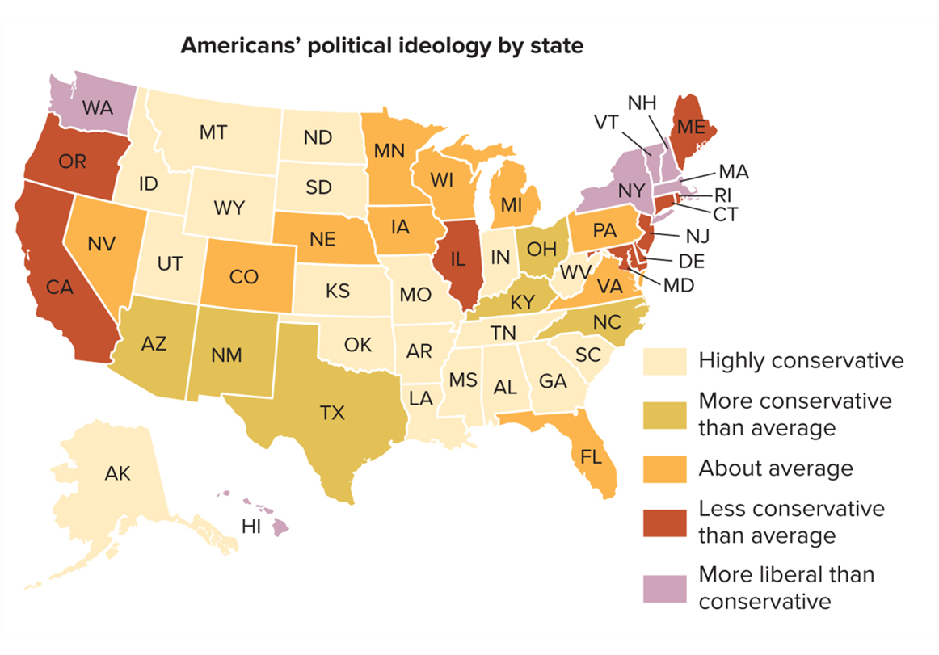
Figure 6.5 Ideology in the United States
Access the text alternative for slide images.
SOURCE: Pew Research Center, www.pewresearch.org/wp-content/uploads/2017/03/FT_17.03.16_generations_ideology_2016.png?w=640

Slide 22
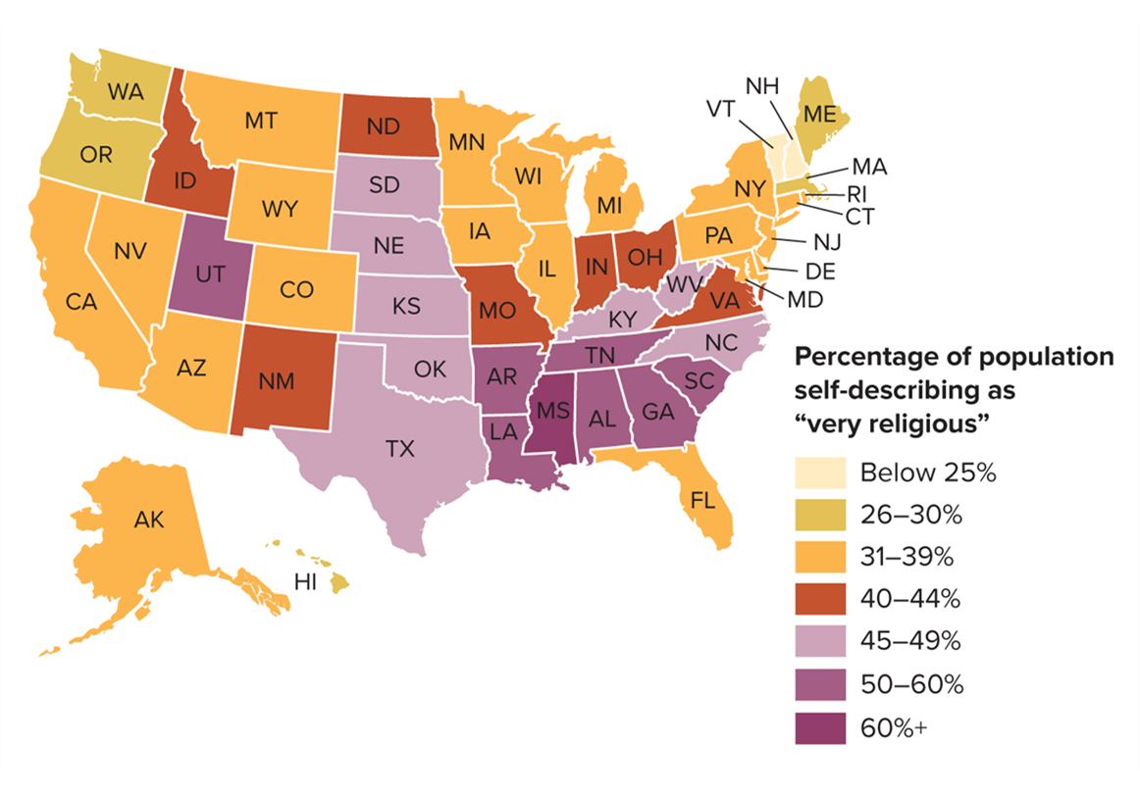
Figure 6.6 Levels of Religiosity in the United States
Access the text alternative for slide images.
SOURCE: Newport, Frank J. New Hampshire Now Least Religious State in U.S. Gallup, February 4, 2016.

Slide 23
Age and Events
Generational effect: the influence of a significant external event in shaping the views of a generation.
9/11 for younger Americans.
Great Depression and World War II for the oldest Americans.

Slide 24
The Socialization and Opinions of Young Americans 1
Millennial generation comprise about a third of the U.S. population.
Majority were “wanted” births, and this informed several spin-off characteristics:
Helicopter parented and socialized in a child-centric era.
Hyper-scheduled “leisure” activities.
Psychology of “specialness.”
American Millennials are the most educated, diverse, and tolerant generation of Americans.

Slide 25
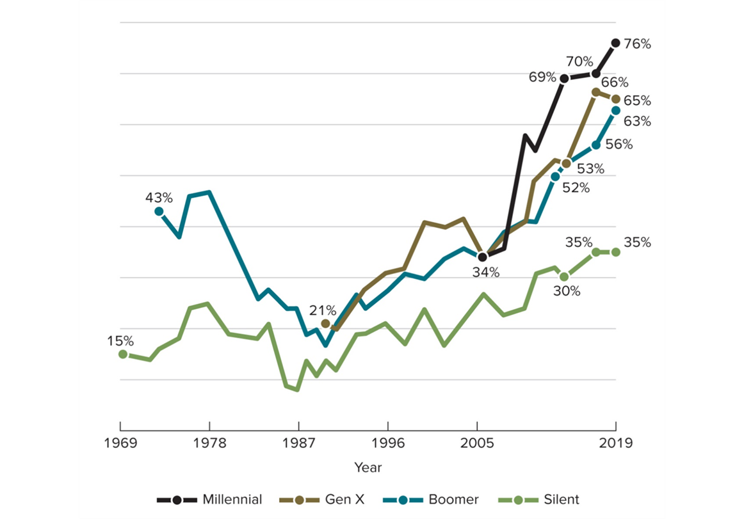
Figure 6.7 Support for Marijuana Legalization by Generation
Access the text alternative for slide images.
SOURCE: Pew Research Center.

Slide 26
Table 6.2 Preferences for Size of Government by Generation
GENERATION | PERCENTAGE FAVORING “SMALLER GOVERNMENT, FEWER SERVICES” | PERCENTAGE FAVORING “BIG GOVERNMENT, MORE SERVICES”
Millennials | 42% | 50%
Gen X | 44% | 51%
Baby Boomers | 53% | 44%
Silent | 51% | 43%
Table divided into three columns summarizes preferences for size of government by generation. Column 1 notes names of different generations. The column headers from 2 to 3 are marked as: Percentage favoring "smaller government fewer services" and percentage favoring "big government, more services".
SOURCE: Pew Research Center.

Slide 27
The Socialization and Opinions of Young Americans 2
Following the Millennial generation, members of Generation Z are just coming of age politically.
Some evidence indicates “Gen Z” has opinions similar to that of Millennials.
Gen Z is also surpassing Millennials as the most diverse generation, a characteristic that tends to breed tolerance.

Slide 28
Measuring Public Opinion
Public opinion consists of the public’s expressed views about an issue at a specific point in time.
One of the most important ways public opinion is measured is through the act of voting.
Another important tool that policy makers, researchers, and the public rely on as an indicator of public opinion is the public opinion poll: a survey of a given population’s opinion on an issue at a particular time.

Slide 29
How Public Opinion Polls Are Conducted
Those conducting a poll first need to determine the population they are targeting for the survey—the group of people whose opinions are of interest and about whom information is desired.
Polling organizations construct polls carefully to ensure that the questions actually measure what the client wants to know.

Slide 30
Sampling 1
Pollsters frequently rely on random sampling, a scientific method of selection in which each member of the population has an equal chance at being included in the sample.
However, there are number of methodological problems in obtaining a truly random sample.
Population identification.
Landline to cellular transition.
Nonresponse rates among cellular users.

Slide 31
Sampling 2
Quota sampling is a more scientifically sophisticated method of sampling than random sampling.
Pollster using this method structures the sample so that it is representative of the characteristics of the target population.
Another method used to address problems in sampling is stratified sampling.
National population is divided into fourths, and certain areas within these regions are selected as representative of the national population.

Slide 32
Sampling Error
Key to accurate opinion polls is having a sample that accurately reflects the population.
To adjust for problems with sampling, polls use a compensatory calculation called a sampling error.
Sampling error (or margin of error) is a statistical calculation of the difference in results between a poll of a randomly drawn sample and a poll of the entire population.
Most polls have a sampling error of plus or minus 3 percentage points.

Slide 33
Types of Political Polls
Tracking polls measure changes in public opinion over the course of days, weeks, or months by repeatedly asking respondents the same questions and measuring changes in opinion.
Push polls attempt to skew public opinion about a candidate and provide information to campaigns about candidate strengths and weaknesses.
Exit polls are conducted at polling places on Election Day to project the winner of an election before the polls close.

Slide 34
What Americans Think About Politics
Public opinion research is the means by which individuals can convey their opinions and priorities to policy makers.
Consequently, public opinion polls connect Americans to their government.

Slide 35
The Most Important Problem
In 2020, 32 percent of Americans said that dissatisfaction with government/poor leadership was the most important problem.
For the past decade, economic issues had dominated; but just 11 percent of Americans identified economic issues as their top concern in 2020.

Slide 36
Public Opinion About Government 1
For decades, public opinion researchers have measured the public’s trust in government.
Survey respondents are asked to rate their level of trust in the federal government’s ability to handle domestic and international policy matters and to gauge their amount of trust and confidence in the executive, legislative, and judicial branches of government.

Slide 37
Public Opinion About Government 2
Individual officeholders can use the data as a measure of how well they are performing their jobs.
Trust in government is one measure of the public’s belief that the government is working for them.
If people trust their government, they are more likely to believe that it is responsive to citizens’ needs.
Trust peaked just after 9/11 but sank as conflicts continued.
Faith in Obama’s ability to handle international problems increased leading up to the 2012 election but declined after an early bungled response to ISIS.

Slide 38
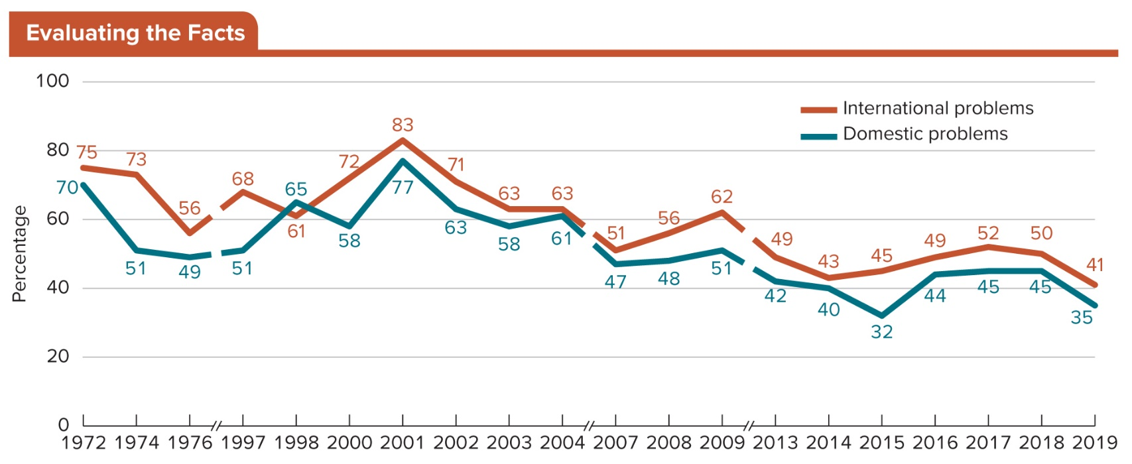
Figure 6.8 Trust in Government to Handle International and Domestic Problems
Access the text alternative for slide images.
SOURCE: Jeffrey M. Jones “Trust in Government,” Gallup.

Slide 39
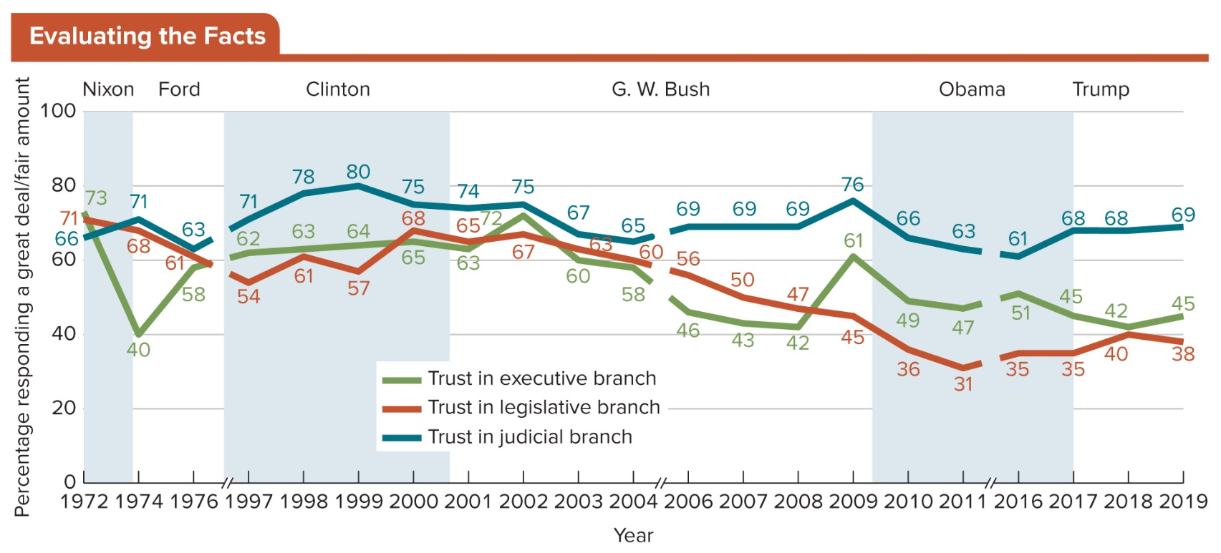
Figure 6.9 Trust in the Branches of Government
The public’s trust in the executive branch declined steeply (from 73 percent to 40 percent in two years) during the Nixon presidency as a result of the Watergate scandal. The declines during George W. Bush’s and Barack Obama’s presidencies were more gradual, from 72 percent to 42 percent and 61 to 43 percent, respectively, in six years.
Access the text alternative for slide images.
SOURCE: Jeffrey M. Jones, “Trust in Government,” Gallup.

Slide 40
Public Opinion About Government 3
Congress also faces ups and downs in terms of its public approval rate.
Since the early 2000s the legislative branch has failed to win approval from the majority of Americans.
Judicial branch consistently scores higher in levels of public trust than do the other two branches.

Slide 41
Review 1
Then—Families and schools were the most important influences on children as they developed their political views.
Now—Families and schools remain influential, but the media have increased their multiple roles in developing the political views of members of the Millennial generation and Generation Z.

Slide 42
Review 2
Next:
How will technology affect the socialization of new generations of Americans?
How will polling organizations harness the power of the Internet to measure public opinion more accurately?
How will government officials reconcile differences in public opinion between generations of Americans?

Slide 43
End of Main Content
Copyright 2022 © McGraw Hill LLC. All rights reserved. No reproduction or distribution without the prior written consent of McGraw Hill LLC.

Slide 44
Accessibility Content: Text Alternatives for Images

Slide 45
Figure 6.1 Candidate Preference of Religious and Non-Religious Americans - Text Alternative
Return to parent-slide containing images.
The horizontal axis represents frequency, while vertical axis represents percentage ranging from 0 to 80 in increments of 10.
The data (in percentage) is as follows:
Once a week or more:
Republican congressional candidates: 40; and Democratic congressional candidates: 58.
Few times a month:
Republican congressional candidates: 52; and Democratic congressional candidates: 46.
Few times a year:
Republican congressional candidates: 61; and Democratic congressional candidates: 37.
Never:
Republican congressional candidates: 68; and Democratic congressional candidates: 30.
Return to parent-slide containing images.

Slide 46
Figure 6.3 Party Identification Among Men and Women - Text Alternative
Return to parent-slide containing images.
A line graph shows the party identification amongst men and women from 1992 to 2018. Except for 1994 and 2002, the majority of women is leaned Democratic, peaking at over 55% in 2008 and 2017. Except for 1994, 1995, and 2002 Republican women have never made up more than 40%, reaching a low of 34% in 2007 and 2008. Men have tended to lean more Republican than Democratic except for the period of 2006 two 2009. In 1994 and 1995 approximate the 52% of men identified as Republican, in 1992 by contrast about 48% of men leaned Democrat, compared to only 44% Republican.
Return to parent-slide containing images.

Slide 47
Figure 6.4 Percentage of Registered Voters Saying Issue Should Be a Top Priority - Text Alternative
Return to parent-slide containing images.
The graph shows the percentage of registered voters saying each policy issue is “very important” to their vote in 2020:
Gun policy: 36% of men, 56% of women.
Climate change: 44% of men, 60% of women.
Health care costs: 62% of men, 72% of women.
Poor and needy: 52% of men, 62% of women.
Jobs: 44% of men, 54% of women.
Environment: 59% of men, 69% of women.
Education: 63% of men, 71% of women.
Race relations: 41% of men, 48% of women.
Crime: 54% of men, 58% of women.
Drug addiction: 48% of men, 52% of women.
Infrastructure: 49% of men, 49% of women.
Terrorism: 73% of women, 74 % of men.
Economy: 67% of women, 68% of men.
Social security: 62% of women, 64% of men.
Military: 45% of women, 48% of men.
Budget deficit: 49% of women, 57% of men.
Immigration: 51% of women, 59% of men.
Global trade: 38% of women, 46% of men.
Return to parent-slide containing images.

Slide 48
Figure 6.5 Ideology in the United States - Text Alternative
Return to parent-slide containing images.
The provinces are marked for state population in the following categories:
The data is as follows:
Highly conservative:
It includes states of Alaska, Idaho, Utah, Montana, Wyoming, North Dakota, South Dakota, Kansas, Oklahoma, Missouri, Arkansas, Louisiana, Mississippi, Alabama, Georgia, South Carolina, Tennessee, Indiana, and West Virginia.
More conservative than average:
It includes states of Arizona, New Mexico, Texas, Ohio, Kentucky, and North Carolina.
About average:
It includes provinces of Nevada, Colorado, Nebraska, Minnesota, Iowa, Wisconsin, Michigan, Pennsylvania, Virginia, and Florida.
Less conservative than average:
It includes states of Oregon, California, Illinois, Maryland, Delaware, New Jersey, and Maine.
More liberal than conservative:
It includes states of Washington, Hawaii, New York, Vermont, New Hampshire, Massachusetts, and Rhode Island.
Return to parent-slide containing images.

Slide 49
Figure 6.6 Levels of Religiosity in the United States - Text Alternative
Return to parent-slide containing images.
The provinces are marked for state population in the following categories:
The data is as follows:
Below 25 percent:
It includes states of Vermont and New Hampshire.
26 to 30 percent:
It includes states of Washington, Oregon, Hawaii, Massachusetts, and Maine.
31 to 39 percent:
It includes states of Alaska, Arizona, California, Nevada, Montana, Wyoming, Colorado, Minnesota, Iowa, Wisconsin, Illinois, Michigan, Florida, New York, Connecticut, Pennsylvania, New Jersey, Delaware, and Maryland.
40 to 44 percent:
It includes states of Idaho, New Mexico, North Dakota, Missouri, Indiana, Ohio, and Virginia.
45 to 49 percent:
It includes states of South Dakota, Nebraska, Kansas, Oklahoma, Texas, Kentucky, West Virginia, and North Carolina.
50 to 60 percent:
It includes states of Utah, Arkansas, Louisiana, Tennessee, Alabama, Georgia, and South Carolina.
60 percent plus:
It includes state of Mississippi.
Return to parent-slide containing images.

Slide 50
Figure 6.7 Support for Marijuana Legalization by Generation - Text Alternative
Return to parent-slide containing images.
The horizontal axis shows year ranging from 1969 to 2019 in increment of 9 till 2005, while vertical axis shows percentage. The data (in percentage) is as follows:
Millennial:
Curve begins in 2005 at 34 and ends in 2019 at 76 passing through the coordinates (2014, 69) and (2016, 70).
Generation X:
Curve begins in 1989 at 21 and ends in 2019 at 65 passing through the coordinates (2014, 53) and (2016, 66).
Boomer:
Curve begins in 1972 at 43 and ends in 2019 at 63 passing through the coordinates (2012, 52) and (2016, 56).
Silent:
Curve begins in 1969 at 15 and ends in 2019 at 35 passing through the coordinates (2015, 30) and (2017, 35).
Note: All data is approximate.
Return to parent-slide containing images.

Slide 51
Figure 6.8 Trust in Government to Handle International and Domestic Problems - Text Alternative
Return to parent-slide containing images.
Line graph describes the gradually declining trust in government of Americans from 1972 to 2018. In 1972, 75% of Americans believe that government could handle international problems, only 56% did so in 1976, 83% in 2001 51% in 2007, 62% in 2009, and 50% in 2018. Regarding domestic problems, Americans trust in government change from 70% in 1972 to 49% in 1976, 65% in nineteen 9877% in 2001, 61% in 2004, 51% in 2009, 32% in 2015, and 45% in 2018.
Return to parent-slide containing images.

Slide 52
Figure 6.9 Trust in the Branches of Government - Text Alternative
Return to parent-slide containing images.
Line graph shows how Americans trust in government differs depending on executive, legislative core, or judicial branch. Trust in the executive branch dropped from 73% to 40% during Watergate, reached a high of 72% at the beginning of the Bush administration in 2002, dropping to 42% at the end, and dropping again after a brief search to 61% in 2009. Trust in the legislative brands has eroded steadily from 1972 two 2011 from 71% to 31%, recovering since then to 40% today. Trust in the judicial branch has been comparatively high ranging from 66% in 1972 to 80% in 1999, 65% in 2004, 76% in 2009, and 68% today.
Return to parent-slide containing images.

